Slide 1
Phasing & Scope for Expansion

Slide 2
OP CLINICS
PHASING

Slide 3
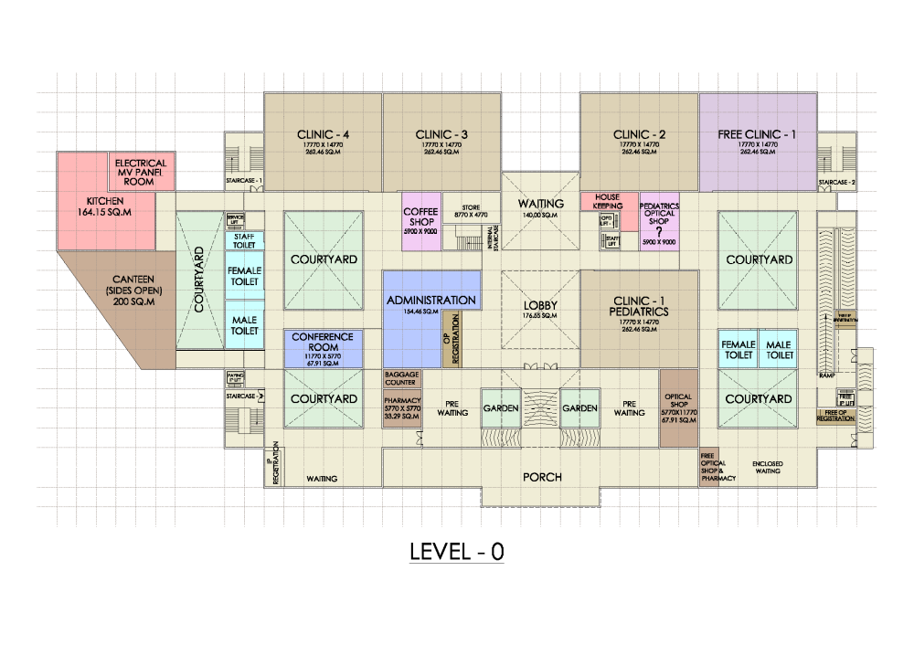

Occupying ground floor only (for 40% of total patient load)
Paying clinics – 4
Free clinic – 1
OP CLINICS – PHASE 1

Slide 4
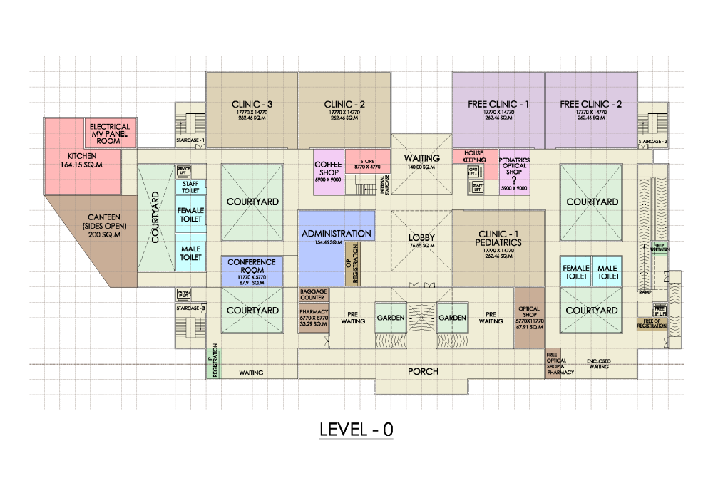
Occupying both ground & first floor (for 70% of the total load)
Paying Clinics – 7
Free Clinics - 2
OP CLINICS – PHASE 2

Slide 5
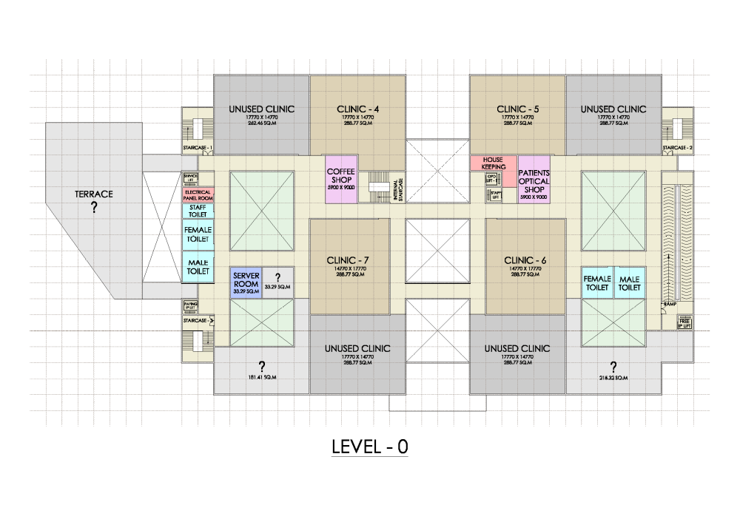
Occupying both ground & first floor (for 70% of the total load)
Paying Clinics – 7
Free Clinics - 2
OP CLINICS – PHASE 2

Slide 6
Occupying both ground & first floor (for 100% of the total load)
Paying Clinics – 11
Free Clinics - 2
OP CLINICS – PHASE 3

Slide 7
EXPANSION
POSSIBILITIES

Slide 8
BUILDING CONFIGURATION - EXPANSION POSSIBILITIES
FOURTH FLOOR
TEACHING & TRAINING FACILTY
AVAILABLE FOOT PRINT – 36%
(FOR EXPANSION)
Level +4
THIRD FLOOR
OT COMPLEX
Level +3
AVAILABLE FOOT PRINT – 18%
(FOR EXPANSION)
SECOND FLOOR
IP ROOMS & WARDS
Level +2
AVAILABLE FOOT PRINT – 11%
(FOR EXPANSION)
Level +1
AVAILABLE FOOT PRINT – 18%
(FOR EXPANSION)
FIRST FLOOR
OP CLINICS (PAYING)
GROUND FLOOR
OP , IP REGISTRATION
& OP CLINICS (PAYING & FREE)
Level 0
BASEMENT FLOOR
PARKING
Level -1

Slide 9
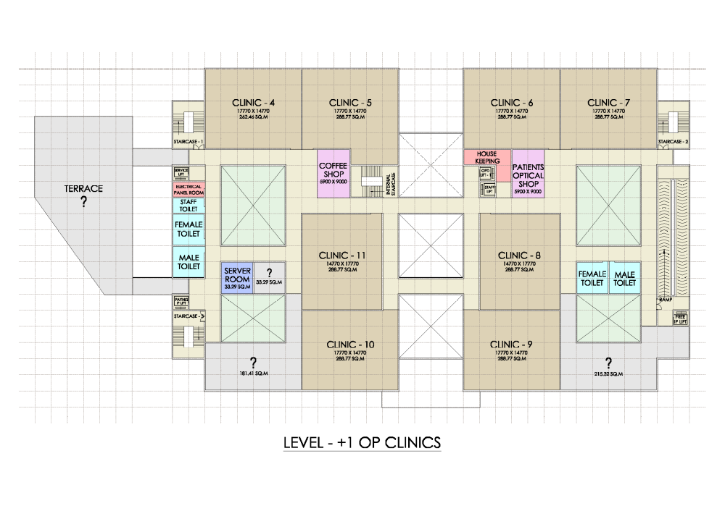
EXPANSION POSSIBILITY
Space available for future expansion

Slide 10
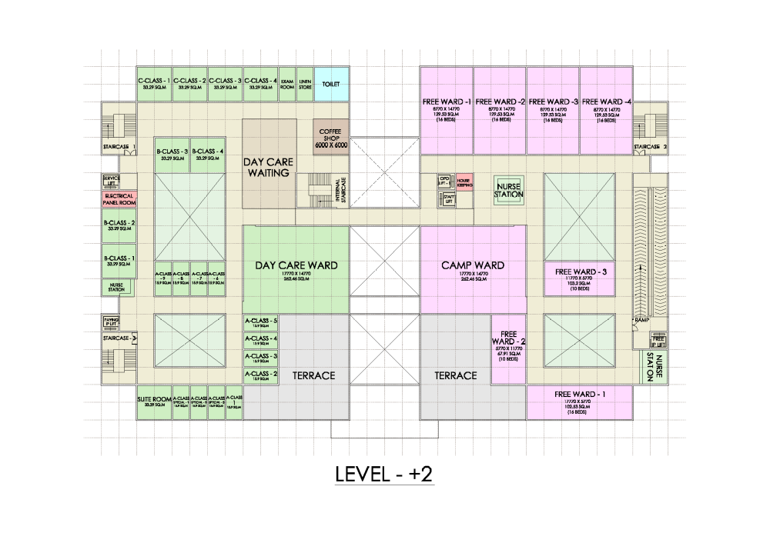
EXPANSION POSSIBILITY
Space available for future expansion

Slide 11
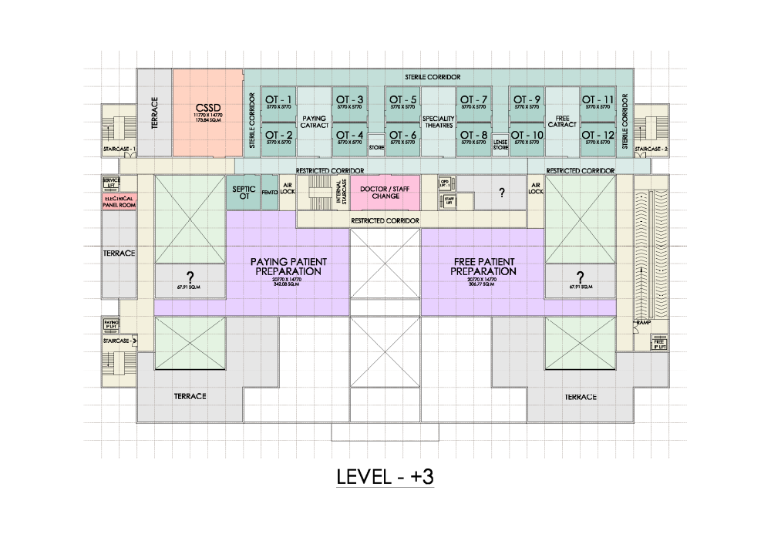
EXPANSION POSSIBILITY
Space available for future expansion

Slide 12
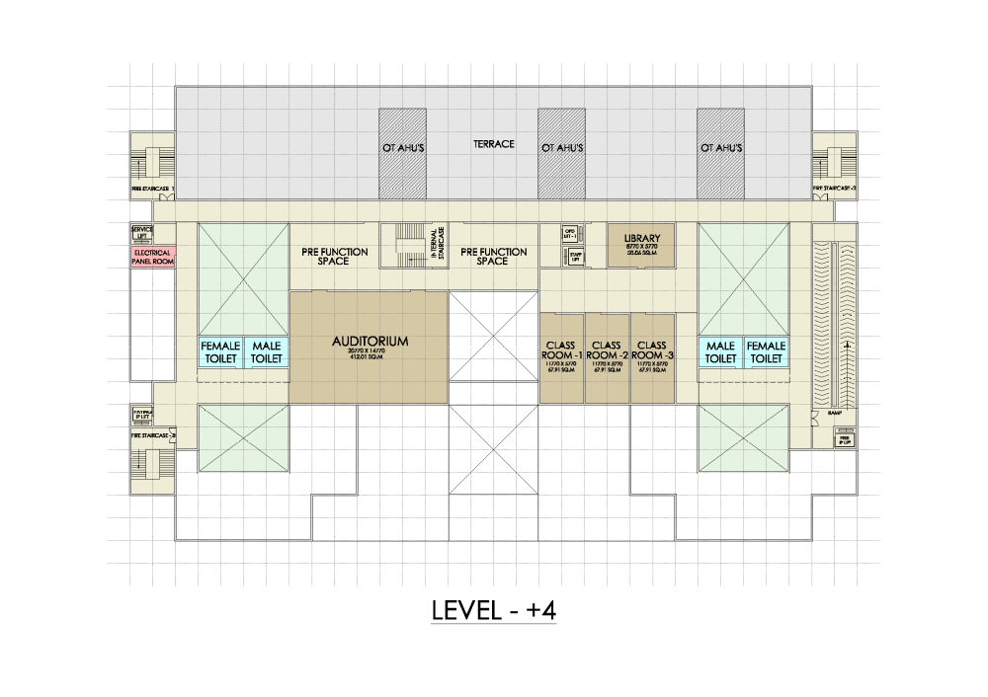
EXPANSION POSSIBILITY
Space available for future expansion

